Slide 1
CSE327 Software Engineering
AKM iqtidar Newaz [IqN]
Lecture - 7

Slide 2
Agile
Let’s think about waterfall model for a big application like banking app, insurance application. Here, a huge application consists of small parts.
It does not matter how many services are there. All together are shipped as a one whole application. That’s how thinks worked previously, and this application was called monolithic application.
Front End
Back End
DNS, Services

Slide 3
Agile
Till 2002 it was fine.
However, whenever one of the services is down, whole system is down.
That’s when Agile came to the picture and played an important part here.
Agile is a philosophy to rapidly deploy an application in much more organized way.
It is a chain of rapid development and deployment.

Slide 4
Agile
Test
Test
Test
Develop
Develop
Develop
Deploy
Deploy
Deploy
Preview
Design
Preview
Design
Preview
Design
Plan
Launch
Plan
Launch
Plan
Launch
First Iteration
Second Iteration
Third Iteration
Here, we work on one microservices at a time.
So, in the first iteration, we will be working on a specific task, then another one in another iteration.

Slide 5
Key Terms of Agile
People over processes and tools: A development and client centric solution.
Working software over comprehensive documentation: Functional application development is more important than the documentation.
Customer collaboration over rigid contracts: Agile is feedback dependent.

Slide 6
Principles of Agile
Satisfy the customer.
Welcome changing requirement.
Deliver working software frequently.
Frequent interaction with stakeholders.
Motivated individuals.
Face to face communication.
Measure by working software.
Maintain constant space.

Slide 7
Principles of Agile
Sustain technical excellence and good design.
Keep it simple.
Empower self-organizing terms.
Reflect and adjust continuously.

Slide 8
Advantage of Agile
Persistent software delivery.
Increased stakeholder satisfaction.
Inspect and adapt.
Welcome to changes at any stage.
Design is important.
Daily interaction

Slide 9
How to Implement Agile
SCRUM
Extreme Programming (XP)
LEAN
KANBAN
CRYSTAL

Slide 10
SCRUM
An iterative approach of planning, building, testing, and reviewing.
Here, the product owner is responsible for deployment.
He/she doesn’t need to be a technical person.
We will have a Scrum master who is a team leader.
Scrum master handles day to day tasks.
Roles in Scrum:
Product owner
Scrum master
Team (Developer, Tester)

Slide 11
Development in SCRUM
Product Backlogs: In the first iteration a specific task is done. Another specific task is done in the second iteration. Product owner and scrum master usually develop the product backlog.
User Stories: Each task is called user stories and prioritize the product backlog tasks.
Sprint Backlog: Here, development team got involved. We have sprint planning where product owner mentioned about the end goals or how the product will look like at the end of the day. We will have Daily Scrum -15 minutes stand-by meeting by developer, tester and others.

Slide 12
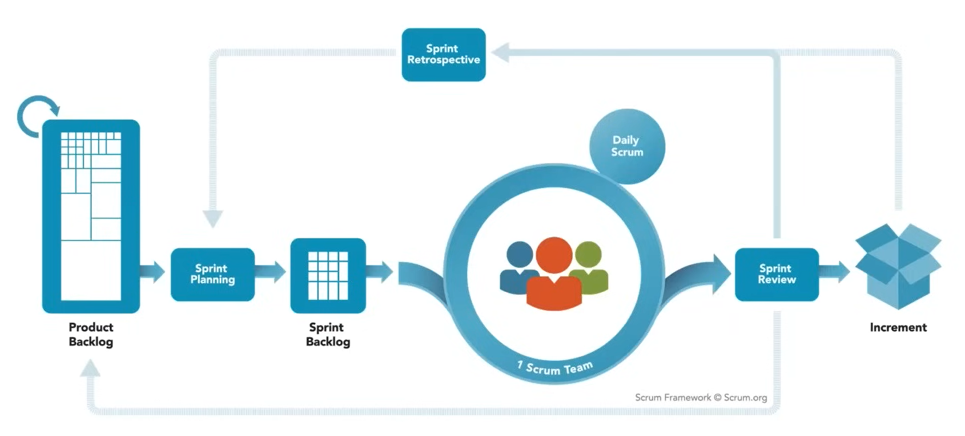
SCRUM

Slide 13
Development in Scrum
Sprint Reviews: At the end of every user stories[sprint backlogs], usually after 2-4 weeks there will be a demo and then move to next sprint.

